Slide 1
VPS HEALTHCARE · CONFIDENTIAL
Delhi Precision Hospital Prototypes
Five Quaternary Hospital Prototypes
QUTUB INSTITUTIONAL AREA · NEW DELHI
Clinical Programme · Facility Architecture · Global Benchmarks
Concept Overview · June 2026 · Version 3.0

Slide 2
FRAMEWORK
Five Focused Quaternary Institutes
Planned for the Qutub Institutional Area of New Delhi, the campus is conceived not as a single multi-specialty hospital but as five focused quaternary institutes. Each concentrates on one clinical domain, operates as a distinct institution with its own identity, and shares core infrastructure, diagnostics and governance.
POC
BDI
NNC
LLEI
CCH
Precision Oncology Centre
Blood Disorders Institute
Neurology & Neuromuscular Centre
Longevity & Lifespan Extension Institute
Comprehensive Children’s Hospital
Solid-tumour precision oncology
Haemato-oncology, transplant & cellular therapy
Neurosciences, neuromuscular & gene therapy
Precision prevention, regenerative & metabolic medicine
Quaternary paediatric & neonatal care
Each institute is benchmarked against a global and an Indian centre specific to its discipline. Benchmarks are indicative reference models, not affiliations or partnerships.

Slide 3
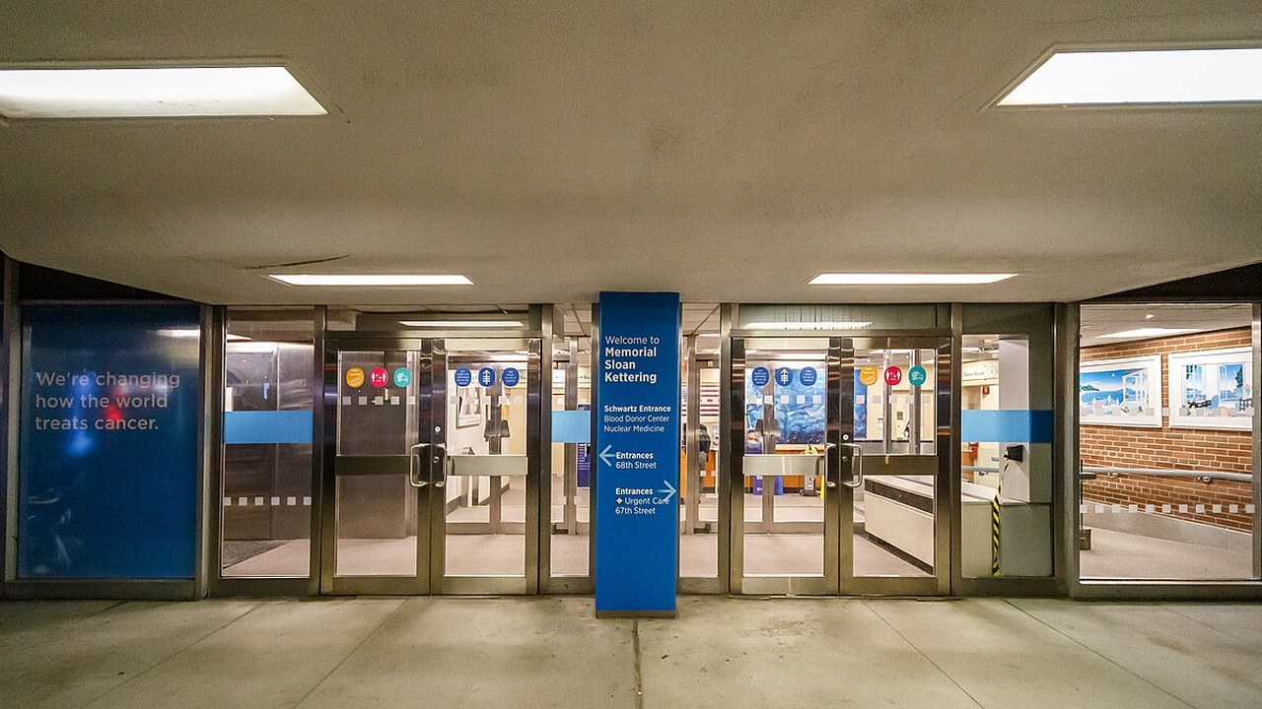
POC
Precision Oncology Centre
DELHI PRECISION HOSPITALS · QUTUB, NEW DELHI
01 / 05
Solid-tumour precision oncology
CLINICAL LOGIC
CLINICAL FLOOR STACK
Complex and rare solid tumours need genomics-guided decisions a general oncology unit cannot sustain. Concentrating sequencing, molecular tumour boards and trials in one institute lets every case be matched to a targeted or trial therapy.
F7 | Future shell: cellular-therapy / CAR-T
F6 | Oncology Wards (48 beds)
F5 | Surgical OT Suite (6) + Sterile Core/CSSD
F4 | Surgical & Oncology ICU
F3 | Chemo Day-Infusion, Aseptic Prep & Trials
F2 | Specialist OPD (20) + Molecular Tumour Board
F1 | Precision Prevention & Genetic Counselling
GF | Reception, Pharmacy, Oncology Urgent Care
B1 | Plant, Central Pharmacy, Stores
B2 | CT, MRI, PET-CT & Nuclear Medicine
B3 | Radiation Oncology: Linac & Brachytherapy
B4 | Central Lab, Molecular Diagnostics & Biobank
BUSINESS LOGIC
Precision oncology draws premium, largely self-pay and insured demand and pulls national and NRI referrals. A genomics-first identity sets the campus apart from general cancer hospitals and anchors its quaternary brand.
CLINICAL SERVICES
MSK CENTER FOR MOLECULAR ONCOLOGY · NEW YORK, USA
Solid-tumour precision oncology — sarcoma, neuro-oncology, rare cancers
NGS treatment selection with integrated molecular tumour boards
Advanced surgical oncology — robotic-assisted resections
Liquid biopsy and circulating-tumour-cell analysis
CAR-T and advanced cellular therapies
GLOBAL BENCHMARK
MSK Center for Molecular Oncology
The clinical genomic-profiling programme behind MSK-IMPACT — tumour sequencing read at a molecular tumour board to match each patient to a targeted therapy or trial. A precision-oncology engine, not an all-cancers hospital.
INDIA BENCHMARK
Patient flow — Linac bunkers and PET/imaging zoned to the basement; OT sits directly above ICU with a co-located sterile core; aseptic chemo prep adjoins day-infusion.
Rajiv Gandhi CI — Molecular Diagnostics · New Delhi
The molecular-diagnostics centre of excellence inside a leading Delhi cancer hospital — NGS gene panels, liquid biopsy and circulating-tumour-cell testing run as a dedicated precision-oncology unit.
3
Image: Kenneth C. Zirkel, CC BY-SA 4.0 · Wikimedia Commons (Memorial Sloan Kettering)

Slide 4

BDI
Blood Disorders Institute
DELHI PRECISION HOSPITALS · QUTUB, NEW DELHI
02 / 05
Haemato-oncology, transplant & cellular therapy
CLINICAL LOGIC
CLINICAL FLOOR STACK
Transplant, CAR-T and inherited blood disorders demand HEPA isolation, cell-therapy manufacturing and intensive haematology support that only a dedicated unit can safely cluster. Co-locating them shortens the path from collection to infusion.
F7 | CAR-T / Cell-Therapy GMP & Cryostore
F6 | BMT HEPA Isolation Unit (10 rooms)
F5 | Haemato-Oncology ICU (20 beds)
F4 | Procedure OT + Apheresis & Cell Collection
F3 | Haemato-Oncology Wards (56 beds)
F2 | Day-Infusion & Transfusion Centre
F1 | Specialist Haematology OPD (18)
GF | Reception, Blood Bank, Sample Collection
B1 | Plant, CSSD, Pharmacy, Stores
B2 | Blood Component Processing & Fractionation
B3 | Haematology Lab, Flow Cytometry, Cytogenetics
B4 | Molecular Sequencing, HLA Lab & Biobank
BUSINESS LOGIC
BMT and cell therapy are scarce, high-value services with long waitlists and strong medical-travel pull. A standalone blood institute captures referrals other centres outsource and positions the campus in advanced cellular therapy.
CLINICAL SERVICES
FRED HUTCHINSON CANCER CENTER · SEATTLE, USA
Adult & paediatric haemato-oncology — leukaemias, lymphomas
Allogeneic & autologous stem-cell transplantation (HSCT)
CAR-T manufacturing and next-generation cellular therapy
Inherited disorders — thalassaemia, sickle cell, haemophilia
Transfusion medicine and therapeutic apheresis
GLOBAL BENCHMARK
Fred Hutchinson Cancer Center
Where allogeneic bone-marrow transplantation was invented (E. Donnall Thomas, Nobel 1990). A blood-cancer and transplant institution specifically — the global reference point for HSCT and cellular immunotherapy.
INDIA BENCHMARK
Patient flow — Cell-therapy GMP sits directly above the BMT isolation it supplies; the ICU underpins transplant one floor below; blood bank on grade above component processing.
CMC — Clinical Haematology · Vellore
India’s bone-marrow-transplant pioneer and among its highest-volume HSCT units, with an established programme for inherited disorders such as thalassaemia.
4
Image: Joe Mabel, CC BY-SA 4.0 · Wikimedia Commons (Fred Hutch, Seattle)

Slide 5
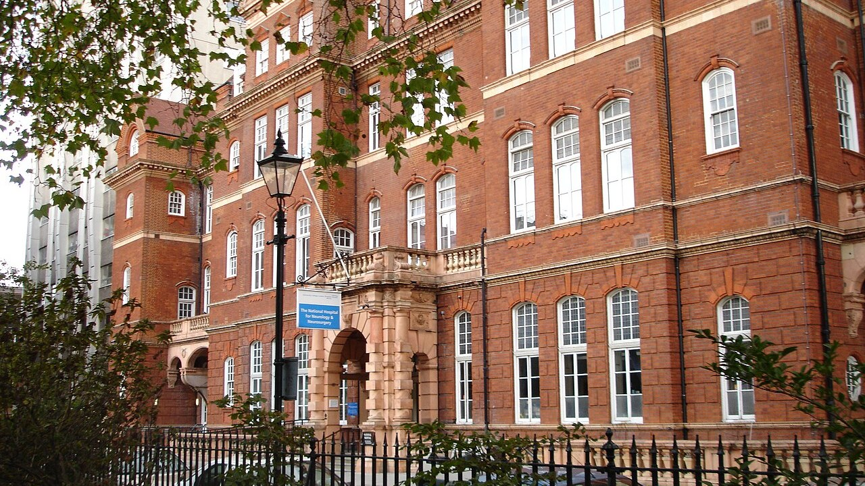
NNC
Neurology & Neuromuscular Centre
DELHI PRECISION HOSPITALS · QUTUB, NEW DELHI
03 / 05
Neurosciences, neuromuscular & gene therapy
CLINICAL LOGIC
CLINICAL FLOOR STACK
Neuromuscular gene therapy, epilepsy surgery and movement disorders need imaging, monitoring and a neuro-surgical–ICU core working as one. A single neuroscience institute keeps complex pathways and rare-disease expertise under one roof.
F7 | Gene-Therapy GMP & Vector Banking
F6 | Neurosurgical OT Suite (4) + iMRI
F5 | Neuro-Critical Care ICU (18 beds)
F4 | Neuro Wards (52) + Epilepsy Monitoring Unit
F3 | Movement Disorders/DBS + Neuro-Rehab
F2 | Infusion Centre (ERT / IVIG / gene therapy)
F1 | Neuro OPD + EMG / Nerve-Conduction Labs (16)
GF | Reception, Vestibular & Gait Labs
B1 | Plant, CSSD, Pharmacy, Stores
B2 | Neuro-Imaging: MRI (3T+1.5T), CT, Angiography
B3 | Neuro-Pathology, Molecular Genetics, CSF Lab
B4 | Gene-Therapy Cryo & Biobank
BUSINESS LOGIC
Neurosciences are referral-dense and under-served at quaternary depth in the region. Gene therapy and deep brain stimulation create marquee programmes that build reputation and draw complex cases from across North India.
CLINICAL SERVICES
NAT’L HOSPITAL FOR NEUROLOGY & NEUROSURGERY · QUEEN SQUARE, LONDON
SMA and neuromuscular gene-therapy manufacturing
Muscular dystrophies, motor-neuron & hereditary neuropathy
Neuro-oncology — brain tumours and complex malignancies
Epilepsy work-up with intra-operative monitoring & surgery
Movement disorders and Parkinson’s with deep brain stimulation
GLOBAL BENCHMARK
Nat’l Hospital for Neurology & Neurosurgery
A hospital that treats nothing but the nervous system — neuromuscular disease, epilepsy and movement disorders — paired with the UCL Queen Square Institute of Neurology. Specialisation by design.
INDIA BENCHMARK
Patient flow — Neuro-OT stacks directly above the neuro-ICU; heavy imaging and angiography are basemented; gene-therapy GMP is isolated at the top of the tower.
NIMHANS · Bengaluru
A standalone Institute of National Importance devoted solely to the neurosciences — India’s deepest single concentration of neurology, neurosurgery and neuromuscular expertise.
5
Image: LordHarris, Public domain · Wikimedia Commons (National Hospital, Queen Square)

Slide 6
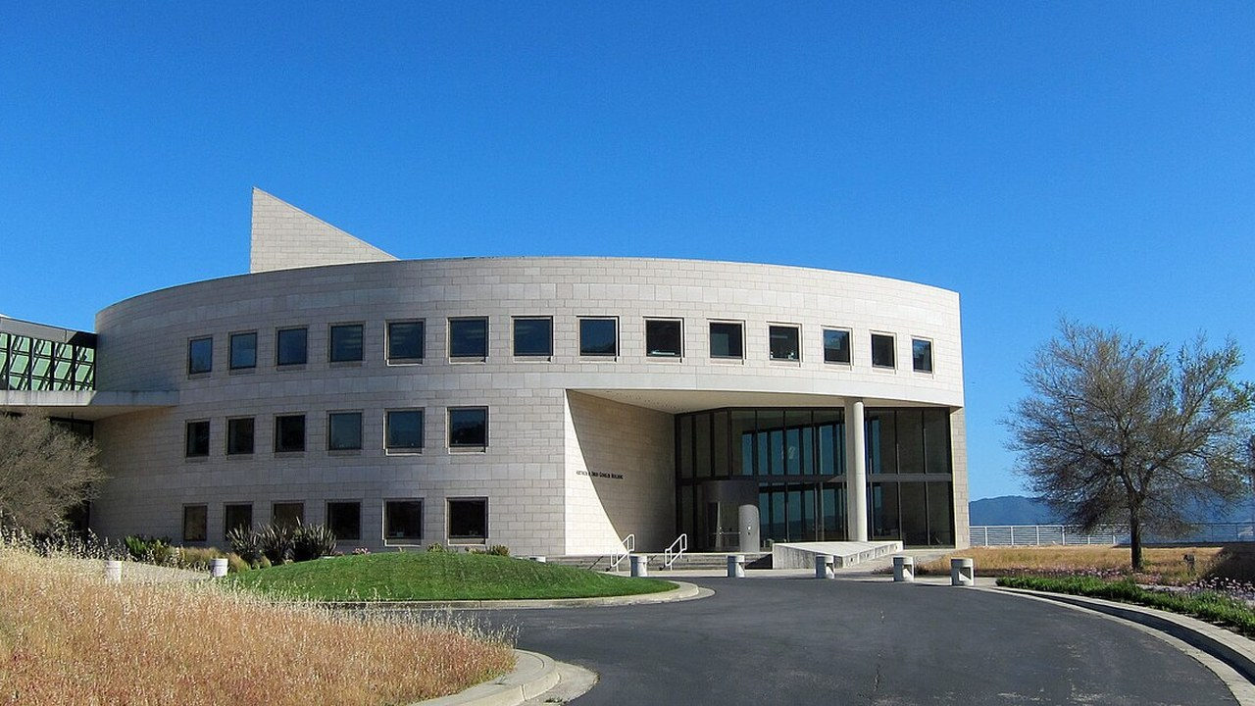
LLEI
Longevity & Lifespan Extension Institute
DELHI PRECISION HOSPITALS · QUTUB, NEW DELHI
04 / 05
Precision prevention, regenerative & metabolic medicine
CLINICAL LOGIC
CLINICAL FLOOR STACK
Precision prevention and regenerative care serve well patients, so their flows must stay entirely clear of acute illness. A concierge institute pairs deep multi-omics assessment with cellular and metabolic interventions in one journey.
F7 | Cellular Reprogramming & GMP shell (future)
F6 | Regenerative Therapy Suite + Cell Bank & Cryo
F5 | Regenerative Medicine & IV-Therapy Clinic
F4 | Day-Surgery OT (4) + Recovery / HDU
F3 | Recovery Suites / Wellness Wards (40 rooms)
F2 | Longevity Assessment & Performance Lab
F1 | Consultation & Precision-Prevention (30 rooms)
GF | Concierge Reception, VIP Lounge, Phlebotomy
B1 | Plant, Pharmacy, Stores, Staff
B2 | Imaging: MRI, CT, PET, Vascular US
B3 | Genomics, Metabolomics & Microbiome Lab
B4 | Cryo-storage Vault & Biobank
BUSINESS LOGIC
Longevity is a fast-growing, fully self-pay segment with affluent and NRI demand and high repeat value. It diversifies the campus beyond sick-care and gives it a distinctive, premium wellness identity.
CLINICAL SERVICES
BUCK INSTITUTE FOR RESEARCH ON AGING · CALIFORNIA, USA
Precision preventive medicine with AI-driven assessment
Cellular rejuvenation and senescence-reversal therapies
Regenerative medicine — cartilage, cardiac, neuronal
Metabolic optimisation and reversal of age-related disease
Cognitive-ageing prevention with amyloid–tau monitoring
GLOBAL BENCHMARK
Buck Institute for Research on Aging
The only independent research institute devoted entirely to the biology of ageing — the source of the geroscience (senescence, healthspan) that a longevity institute exists to translate into clinical care.
INDIA BENCHMARK
Patient flow — The well-patient journey ascends entirely clear of acute flow; the cell-therapy chain is co-located on the upper floors; imaging and multi-omics labs are basemented.
Reliance Foundation — JIVITA · Mumbai
A hospital-based longevity centre on predictive, preventive and personalised medicine — integrating genomics, advanced imaging and metabolic profiling, not routine health checks.
6
Image: ResearcherQ, CC BY-SA 3.0 · Wikimedia Commons (Buck Institute, Novato)

Slide 7
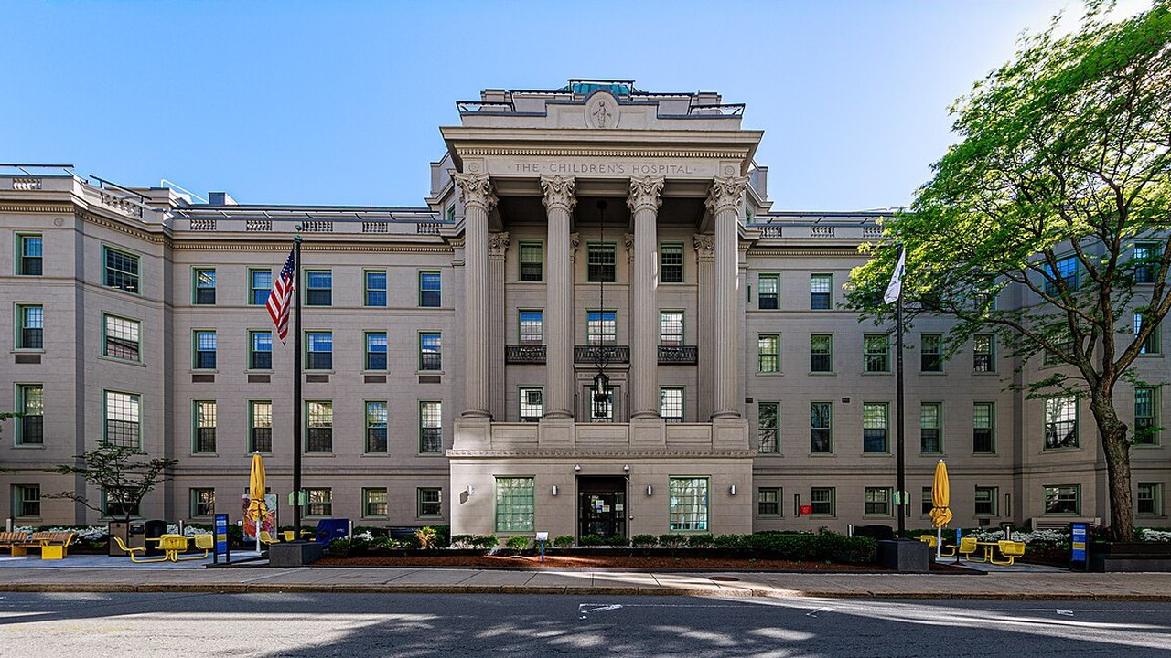
CCH
Comprehensive Children’s Hospital
DELHI PRECISION HOSPITALS · QUTUB, NEW DELHI
05 / 05
Quaternary paediatric & neonatal care
CLINICAL LOGIC
CLINICAL FLOOR STACK
Children need age-segmented wards, paediatric-specific critical care and an emergency pathway kept separate from adults. Clustering NICU, PICU and cardiac surgery lets neonatal and complex cases move safely between them.
F7 | Future paediatric expansion shell
F6 | Paediatric Haemato-Oncology + BMT Isolation
F5 | NICU (30) + PICU (20): paediatric critical care
F4 | Paediatric & Cardiac OT (5) + Cath Lab
F3 | Paediatric Wards (72, age-segmented)
F2 | Paediatric OPD & Day-care (28)
F1 | Outpatient Diagnostics & Procedure Suite
GF | Paediatric Emergency Dept, Triage, Pharmacy
B1 | Plant, CSSD, Pharmacy, Stores
B2 | Imaging: MRI, CT (low-dose), Ultrasound
B3 | Paediatric Lab, Blood Bank & Milk Bank
B4 | Medical Gas, Plant, Mortuary
BUSINESS LOGIC
A dedicated children’s hospital is a trusted, high-volume referral magnet and a powerful family-brand halo. Congenital cardiac surgery and paediatric BMT are scarce services that draw regional and cross-border demand.
CLINICAL SERVICES
BOSTON CHILDREN’S HOSPITAL · BOSTON, USA
Paediatric haemato-oncology and bone-marrow transplant
Congenital heart surgery and paediatric cardiac intervention
Neonatal (NICU) and paediatric (PICU) critical care
Paediatric neurosurgery and complex neurology
Rare genetic disorders and inborn errors of metabolism
GLOBAL BENCHMARK
Boston Children’s Hospital
A free-standing children’s hospital — Harvard-affiliated and the top-ranked paediatric centre in the US — spanning quaternary paediatric surgery, oncology and rare disease. Paediatrics only, end to end.
INDIA BENCHMARK
Patient flow — The ED on grade has a direct vertical link to theatres; NICU and PICU share one critical-care floor immediately above the cardiac OT and cath lab.
Rainbow Children’s Hospitals · India
India’s largest dedicated paediatric, perinatal and neonatal network — high-acuity NICU/PICU, paediatric surgery and children’s quaternary care as its entire remit.
7
Image: Kenneth C. Zirkel, CC BY-SA 4.0 · Wikimedia Commons (Boston Children’s Hospital)

